Slide 1


Today’s Contents
Over the next few lectures we will look at image enhancement techniques working in the spatial domain:
What is image enhancement?
Different kinds of image enhancement
Gray level Transformation function
Point processing
Neighborhood operations
Chapter 3 from R.C. Gonzalez and R.E. Woods, Digital Image Processing (3rd Edition), Prentice Hall, 2008 [ Section 2.5 ] [Exercise Problems 3.1, 3.4, 3.5]

Slide 2
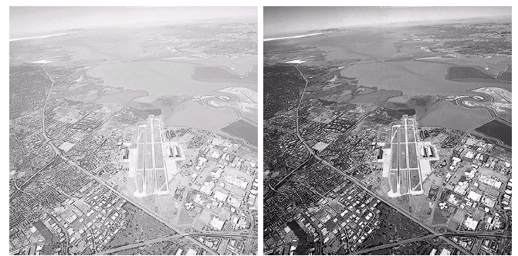
Image Enhancement
2

Slide 3

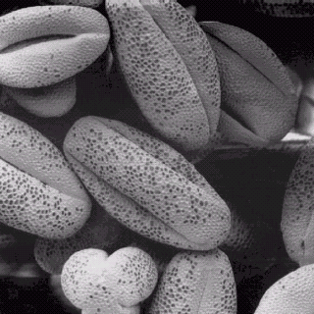
Image Enhancement
3

Slide 4




Image Enhancement
Process an image so that the result is more suitable than the original image for a specific application
Image Enhancement Methods
Spatial Domain: Direct manipulation of pixels in an image
Frequency Domain: Process the image by modifying the Fourier transform of an image
This Chapter – Spatial Domain

Slide 5
Image Enhancement
The reasons for doing this include:
Highlighting interesting detail in images
Removing noise from images
Making images more visually appealing

Slide 6
Basic Concepts
⬥ Most spatial domain enhancement
operations can be generalized as:
g(x, y) = T [ f (x, y)]
f (x, y) = the input image
g (x, y) = the processed/output image
T = some operator defined over some neighbourhood of (x, y)
6

Slide 7



Types of image enhancement operations
⬥ Point/Pixel operations
Output value at specific coordinates
(x,y) is dependent only on the input value at (x,y)
⬥ Local operations
The output value at (x,y) is dependent on the input values in the neighborhood of (x,y)
Global operations
The output value at (x,y) is dependent on all the values in the input image
7

Slide 8

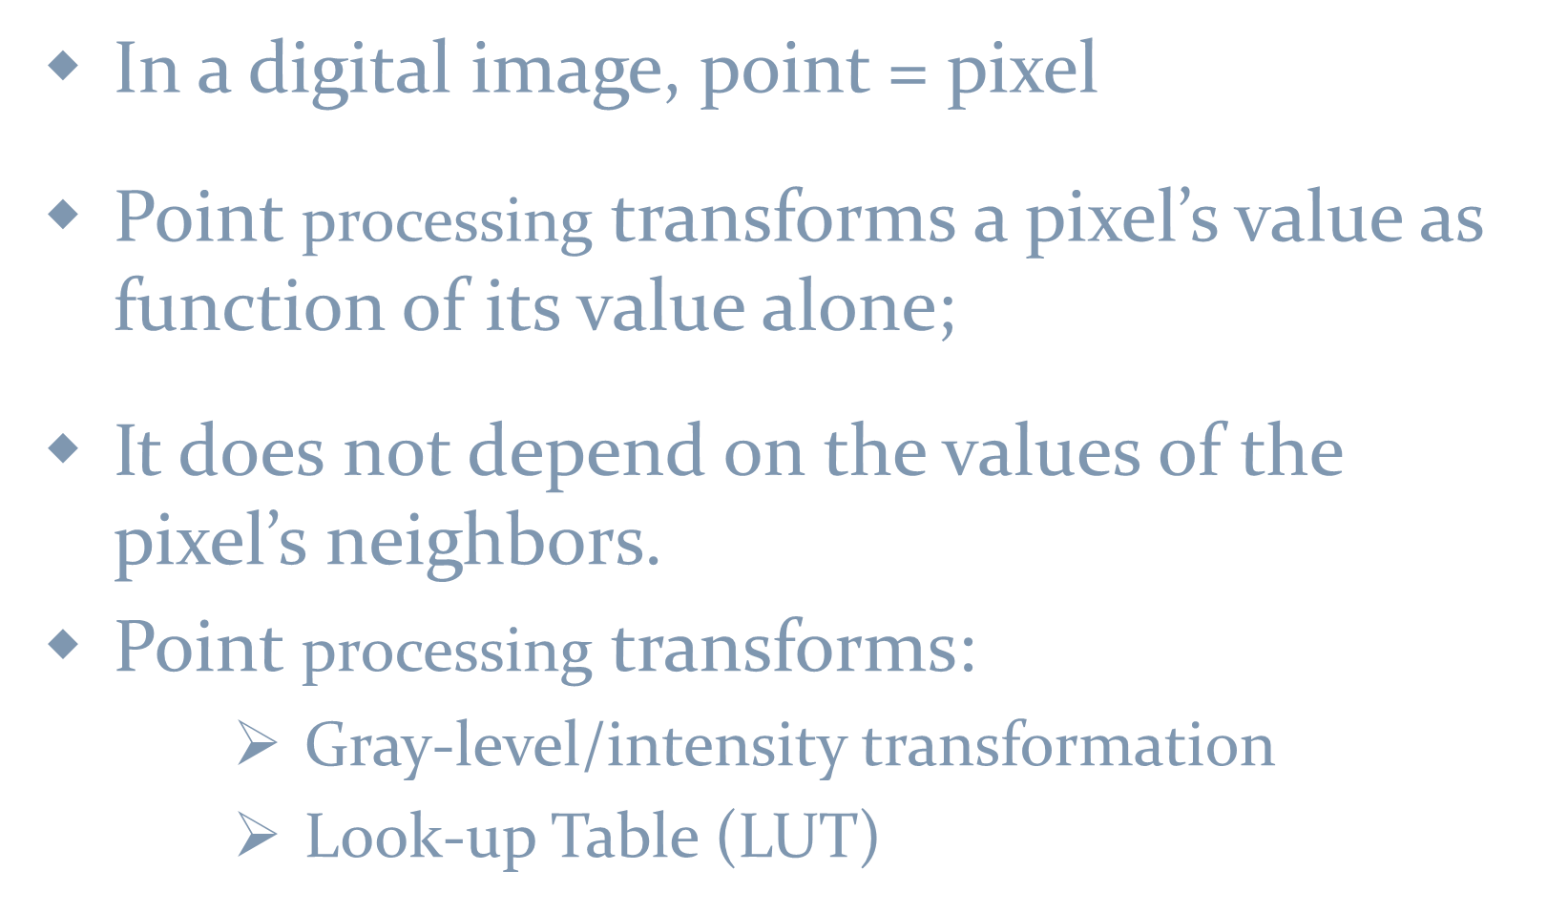
Point Processing
In a digital image, point = pixel
Point processing transforms a pixel’s value as function of its value alone;
It does not depend on the values of the pixel’s neighbors.
Point processing transforms:
Gray-level/intensity transformation
Look-up Table (LUT)
8

Slide 9

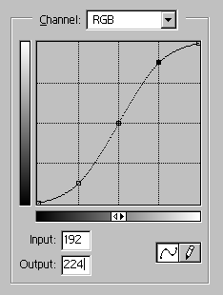
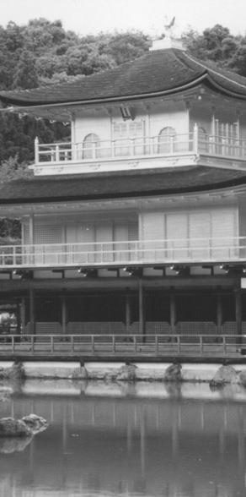
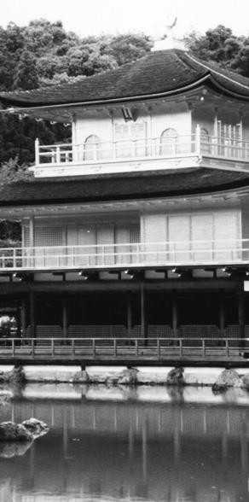




Point Processing using Look-up Tables
input
output
0
0
cell index
.
.
a pixel with
64
32
contents
is mapped to
.
..
128 128
this value
.
this value
.
.
.
192 224
.
.
.
.
255
255
9

Slide 10
Point Processing through Gray level Transformation function
Neighborhood of size 1x1:
g depends only on f at (x,y)
T: Gray-level/intensity transformation/mapping function
s = T (r)
r = gray level of f at (x,y)
s = gray level of g at (x,y)
T = is a function that maps r to s
10

Slide 11
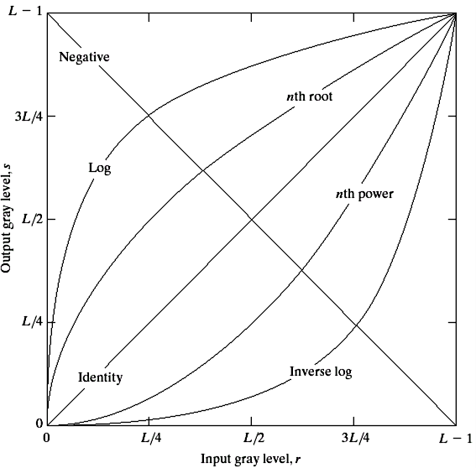
Gray-level/intensity transformation
There are many different kinds of grey level
transformations
Three of the most common are shown here
Linear
Negative/Identity
Logarithmic
Log/Inverse log
Power law
n^{th} power/n^{th} root
11

Slide 12
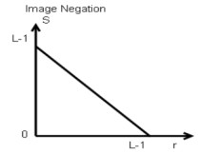
Linear Tranformation Example: Negative Images
Reverses the gray level order
For L gray levels, the transformation (Image Negation) function has the form:
s = (L −1) − r
Negative images are useful for enhancing white or grey
detail embedded in dark regions of an image
12

Slide 13
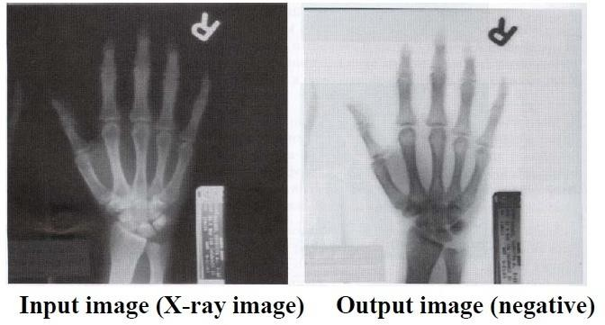
Point Processing Example: Negative Images
13

Slide 14
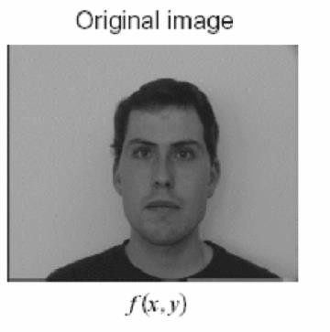
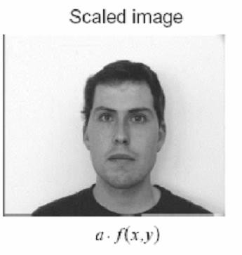
Point Processing Example: Intensity Scaling
s = T (r) = a.r
14

Slide 15
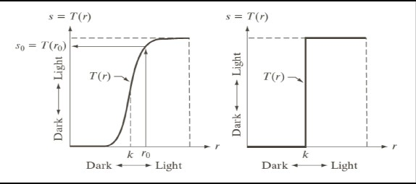
Point Processing: Thresholding
Contrast enhancement:
Darkens level below k
Brightens levels above k
s = T (r)
1.0 r > threshold
0.0 r <= threshold
❑ Replace values below k to black (0.0)
s =
❑ Replace values above k to white (1.0)
DIP, Spring 2012 GS & AS, Bahria University, Islambad

Slide 16
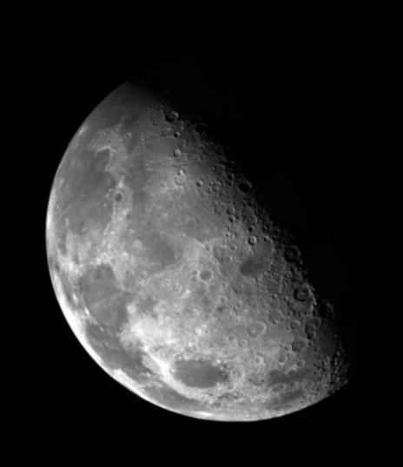
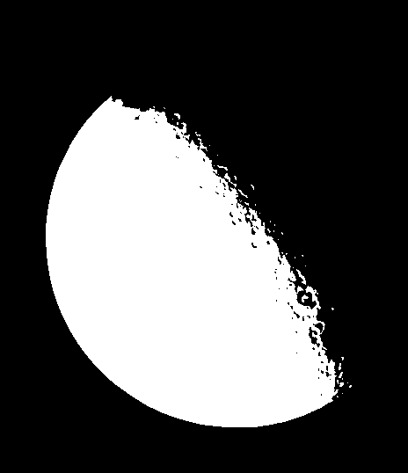
Point Processing Example: Thresholding
Segmentation of an object of interest from a background
1.0 r > threshold
0.0 r <= threshold
s =

Slide 17
Logarithmic Transformations
The general form of the log transformation is
s = c × log(1+ r)
The log transformation maps a narrow range of low input grey level values into a wider range of output values
The inverse log transformation performs the opposite transformation

Slide 18
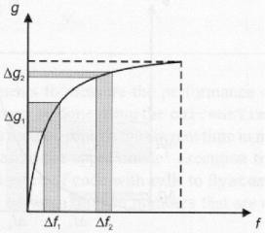
Logarithmic Transformations
⬥ Properties
For lower
amplitudes of
of
input image the range
gray levels is expanded
Out put image →
For higher amplitudes of
of
input image the range gray levels is compressed
Input image →

Slide 19
Logarithmic Transformations
Application
This transformation is suitable for the case when the dynamic range of a processed image far exceeds the capability of the display device (e.g. display of the Fourier spectrum of an image)
Also called “dynamic-range compression / expansion”

Slide 20
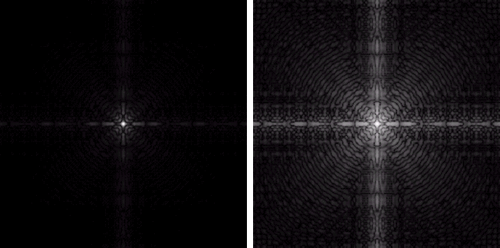
Logarithmic Transformations
Fourier spectrum: image values The result of log transformation ranging from 0 to 1.5x10⁶ with c = 1

Slide 21
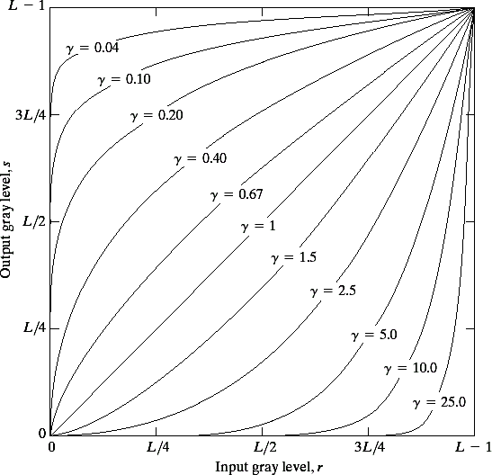
Power Law _{(Gamma)}
Transformations
Power law transformations have the following form
s = c × r^{γ}
Map a narrow range of dark input values into a wider range of output values or vice versa
Varying γ gives a whole
family of curves

Slide 22
Power Law Transformations
⬥ For γ< 1: Expands values of dark pixels, compress
values of brighter pixels
Compresses values of dark pixels, expand
values of brighter pixels
Identity transformation (s = r)
⬥ For γ > 1:
⬥ If γ=1 & c=1:
⬥ A variety of devices (image capture, printing, display)
respond according to a power law and need to be corrected
⬥ Gamma (γ) correction
The process used to phenomena
correct the power-law response

Slide 23
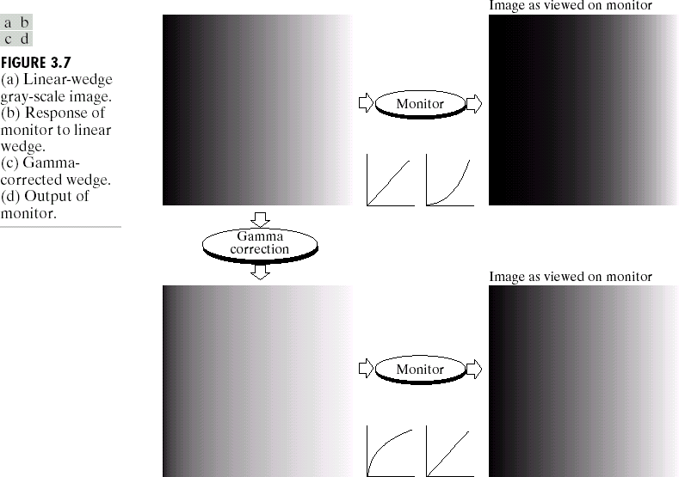
Power Law Transformations: Gamma Correction

Slide 24
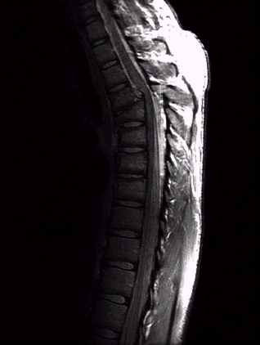
Power Law Transformations Contrast Enhancement
The image to the right show a magnetic resonance (MR) image of
a fractured human spine with dislocation and
spinal cord impingement

Slide 25
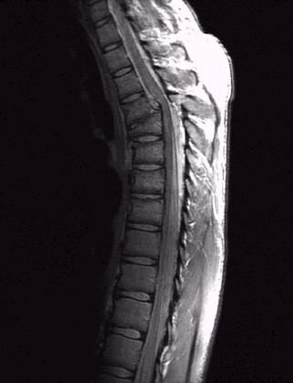
Power Law Transformations Contrast Enhancement
γ = 0.6
1
0.9
0.8
0.7
0.6
0.5
0.4
0.3
0.2
0.1
0
Transformed Intensities
0
0.2 0.4 0.6 0.8
Old Intensities
1

Slide 26
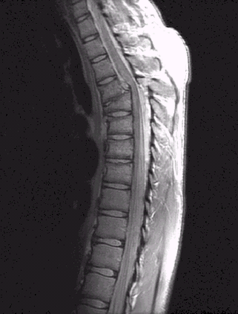
Power Law Transformations Contrast Enhancement
γ = 0.4
1
0.9
0.8
0.7
0.6
0.5
0.4
0.3
0.2
0.1
0
Transformed Intensities
0
0.2
0.4 0.6
Original Intensities
0.8
1

Slide 27
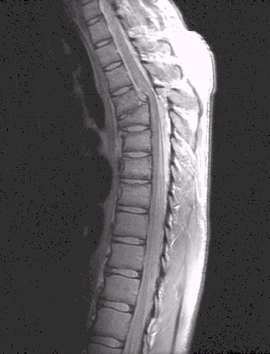
Power Law Transformations Contrast Enhancement
γ = 0.3
1
0.9
0.8
0.7
0.6
0.5
0.4
0.3
0.2
0.1
0
Transformed Intensities
0
0.2
0.4 0.6
Original Intensities
0.8
1

Slide 28
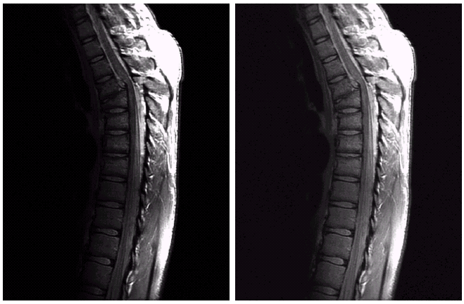
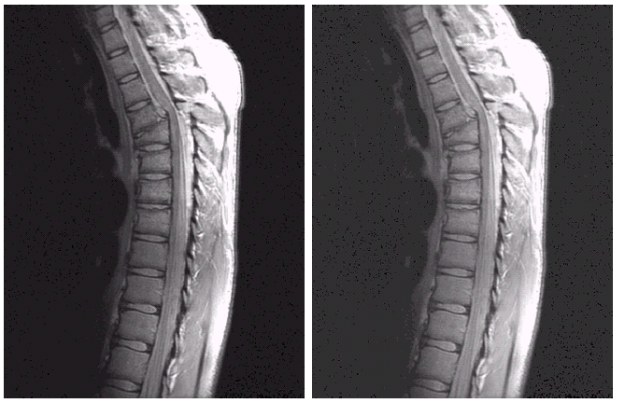
Power Law Transformations Contrast Enhancement
Result after Power law
transformation
c = 1, γ = 0.6
Result after Power law
transformation
c = 1, γ = 0.4
Result after
Power law
transformation
c = 1, γ = 0.3
MR image of
fractured human spine

Slide 29
Power Law Transformations Contrast Enhancement
When the γ is reduced too much, the image begins to
reduce contrast to the point where the image started to have very slight
“wash-out” look.

Slide 30
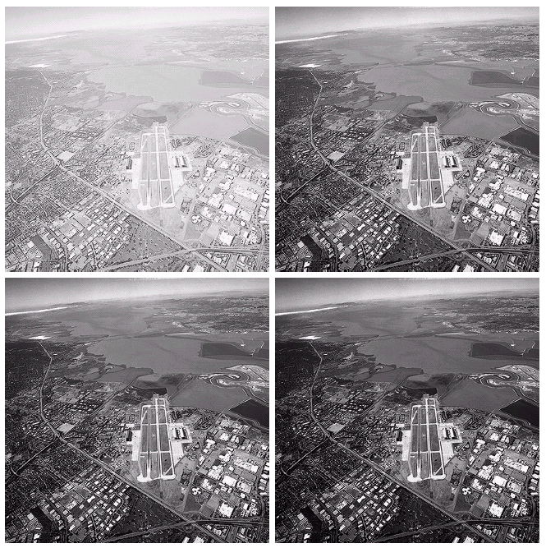
Image Enhancement
Aerial Image
Result of Power law transformation c = 1, γ = 3.0
(suitable)
Image has a washed-out appearance
– needs γ > 1
Result of Power law transformation c = 1, γ = 5.0
(high contrast, some regions are too dark)
Result of Power law
transformation
c = 1, γ = 4.0
(suitable)
ing 2012 GS & AS, Bahria University, Islambad
31

Slide 31
































Piecewise Linear Transformation Functions
Contrast stretching
Intensity level slicing
Bit-Plane slicing

Slide 32
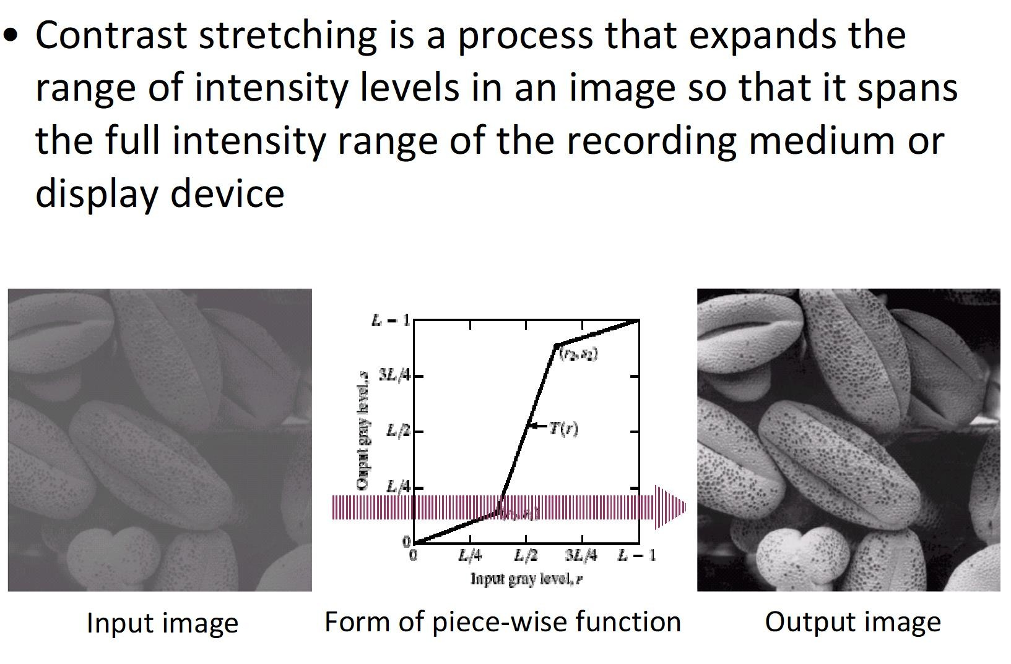
Contrast Stretching

Slide 33
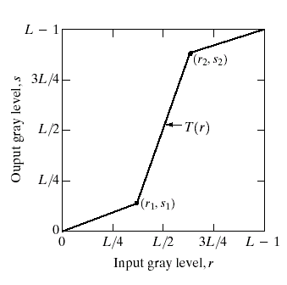
Contrast Stretching
Objective
Increase the dynamic range of the gray levels for low contrast images
Rather than using a well defined mathematical function we can use arbitrary user-defined transforms

Slide 34


Contrast Stretching
If r₁ = s₁ & r₂ = s₂, no change in gray levels
If r₁ = r₂, s₁ = 0 & s₂ = L-1, then it is a threshold function. The resulting image is binary (as in fig 3.10 d)
r₁ = r_{min} & s₁ = 0
r₂ = r_{max} & s₂ = L-1
(as in fig 3.10 c)

Slide 35
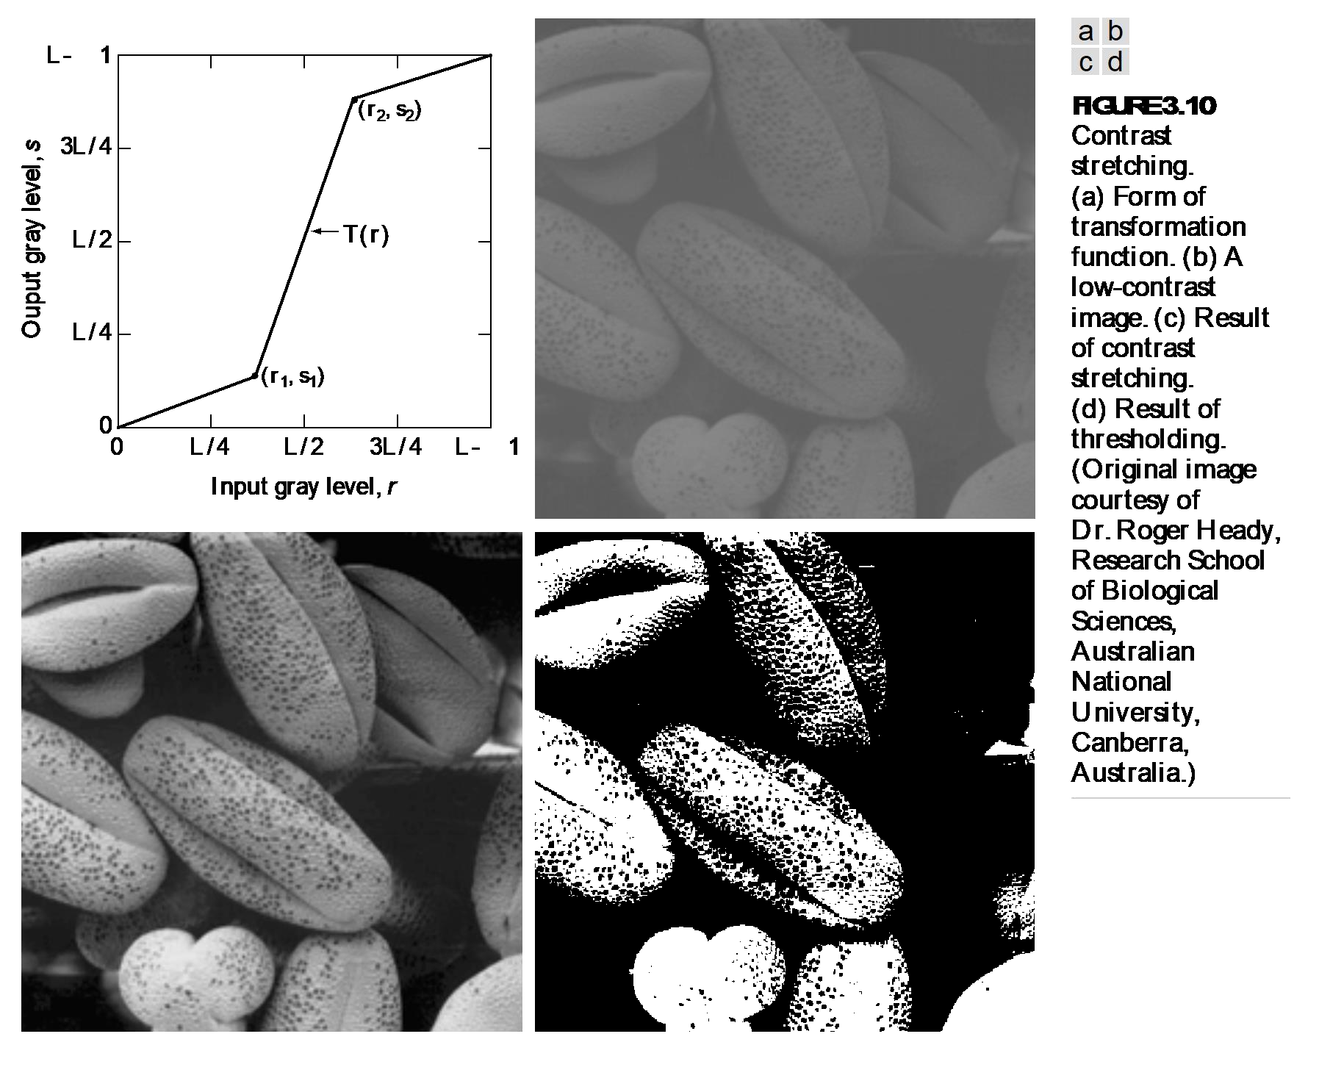

Slide 36
Grey/Intensity Level Slicing
Highlights a specific range of gray levels in an image
Similar to thresholding
Other levels can be suppressed or maintained
Useful for highlighting features in an image

Slide 37
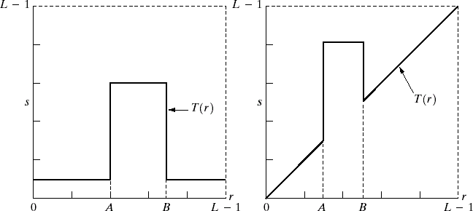
Grey Level Slicing
Two basic approaches
Highlights range [A,B] of gray levels and reduces all others to a lower level
Highlights range [A,B] but preserves all other gray levels

Slide 38

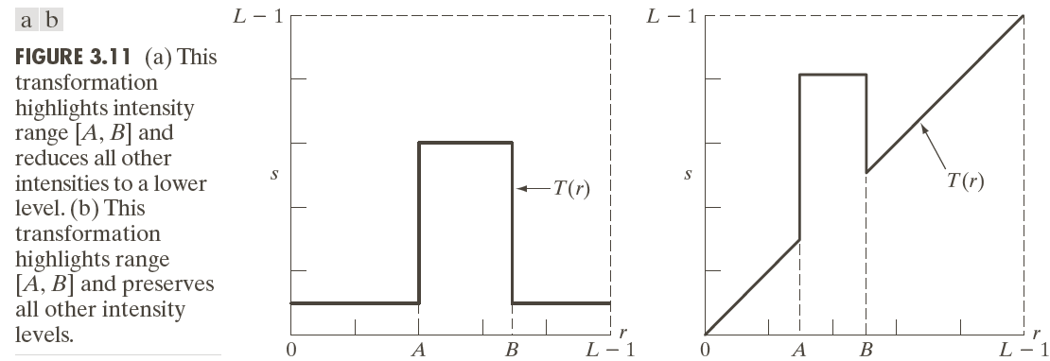
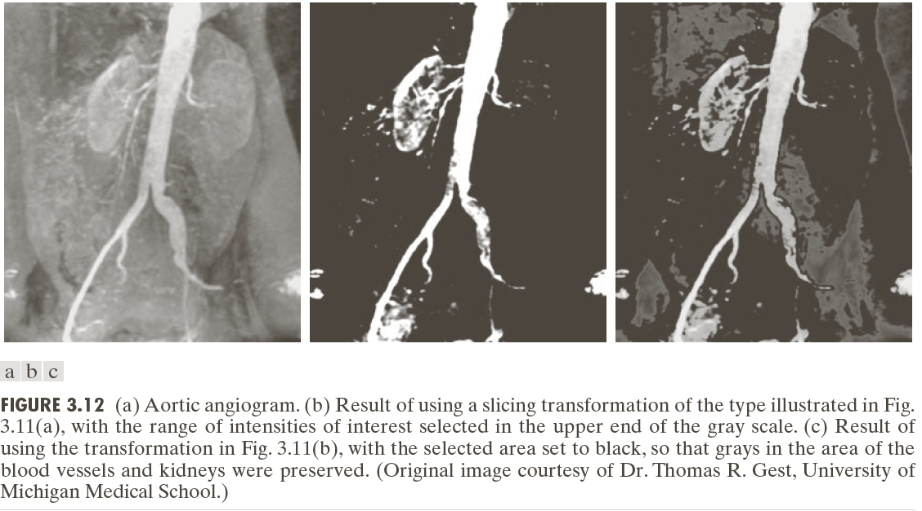
Highlight the major blood vessels and study the shape of the flow of the contrast medium (to detect blockages, etc.)
Measuring the actual flow of the contrast medium as a function of time in a series of images
27-Jan-19 39

Slide 39























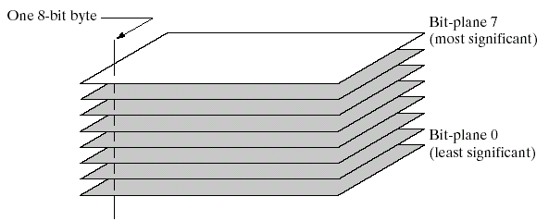
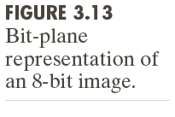
Bit-plane Slicing

Slide 40
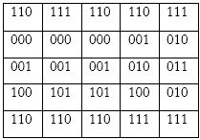
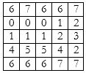
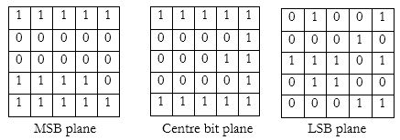
Bit-plane Slicing

Slide 41



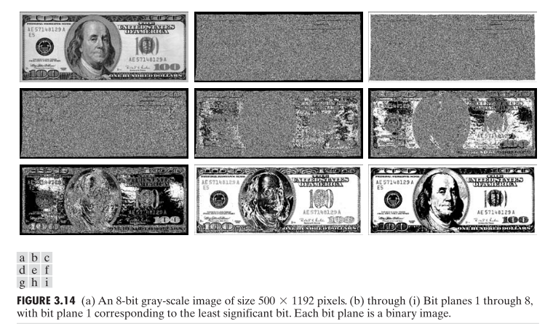
Bit-plane Slicing

Slide 42
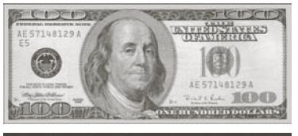
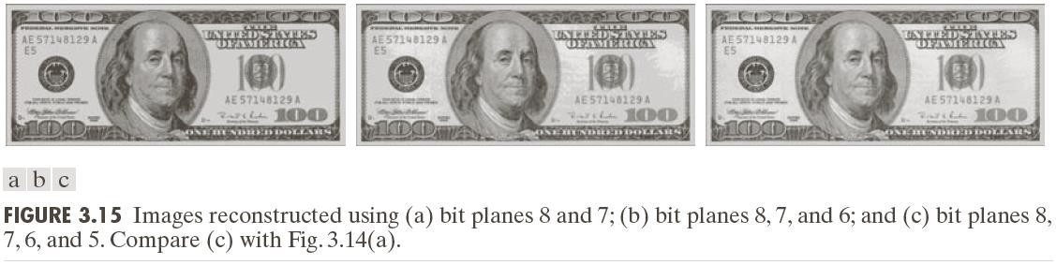
Bit-plane Slicing

